Slide 1
Oceanographically-determined growth variation for NE Pacific Sablefish
Sablefish STAR
July 2019
Maia Kapur
kapurm@uw.edu

Slide 2
Objective of this work
Find/Develop data-driven method to ID spatio-temporal break points in growth
See if there are areas between which sablefish growth differs
Submitted to Fisheries Research

Slide 3

Our method (in a nutshell)
“Let the data talk”
Fit a Generalized Additive Model (GAM) to a single age and sex
$$g\left(μ_{t}\right)=β_{0} +f\left(x_{t}\right)+f\left(s_{1t}\right)+f(s_{2t})+ε_{t}$$
$$length=intercept +smoother(year)+smoother(latitude)+smoother(longitude)+ε_{t}$$
Evaluate 1st derivative of the latitude/longitude/year smoother to see where it is changing most
Notes:
Will show figures shortly

Slide 4
Application to Sablefish
Repeated analysis for ages 4, 6 and 30 for both sexes
Notes:
Ages 4, 6, and 30 (reference ages)

Slide 5
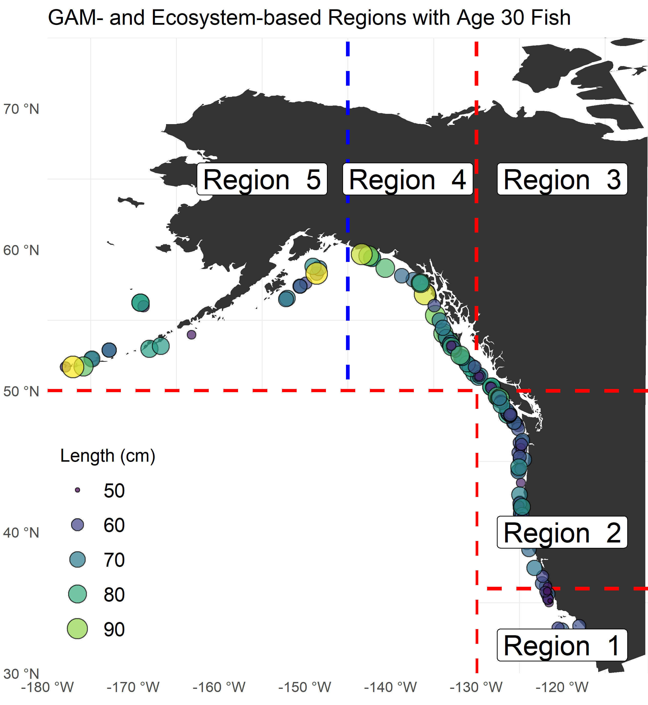
Application to Sablefish
Repeated analysis for ages 4, 6 and 30 for both sexes
Detected 5 regions, including a tested ecosystem break at 145W
Notes:
Ages 4, 6, and 30 (reference ages)

Slide 6
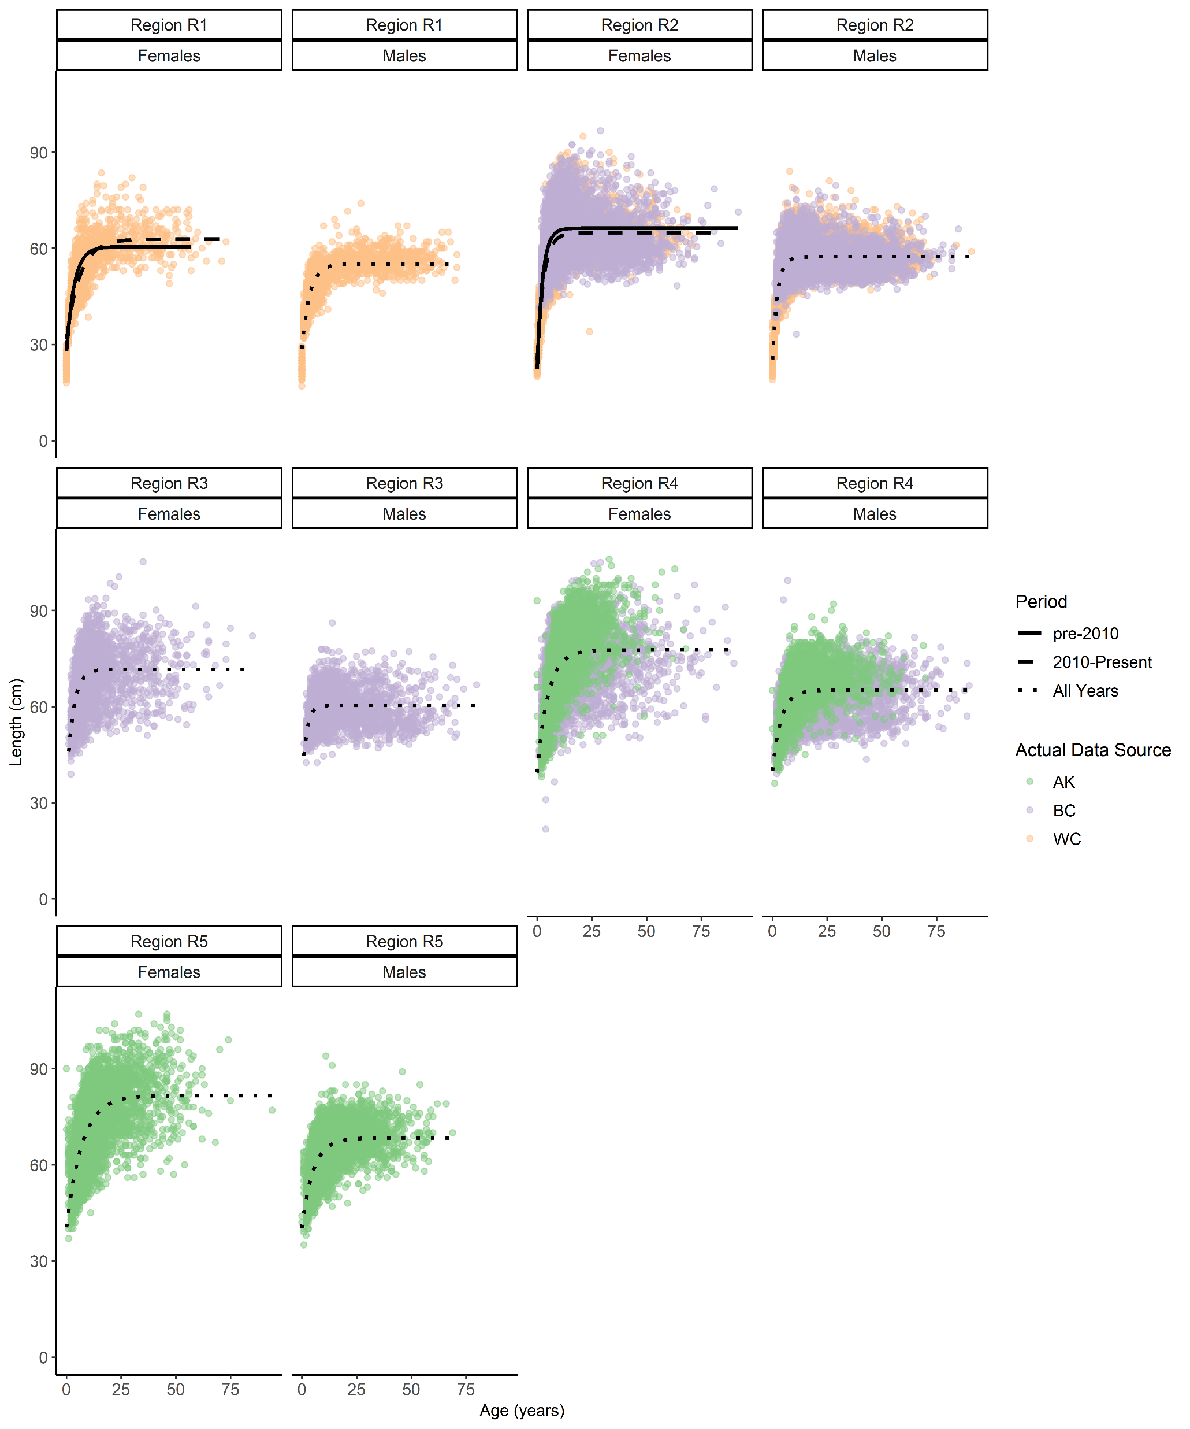
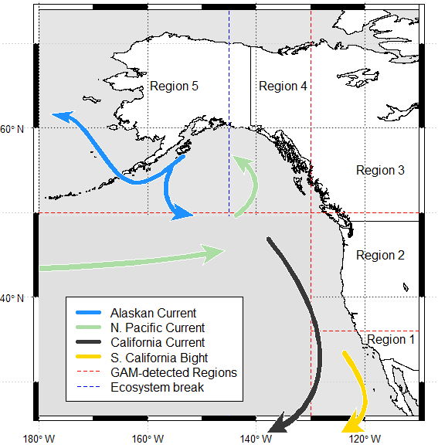
Notes:
Ages 4, 6, and 30 (reference ages)

Slide 8
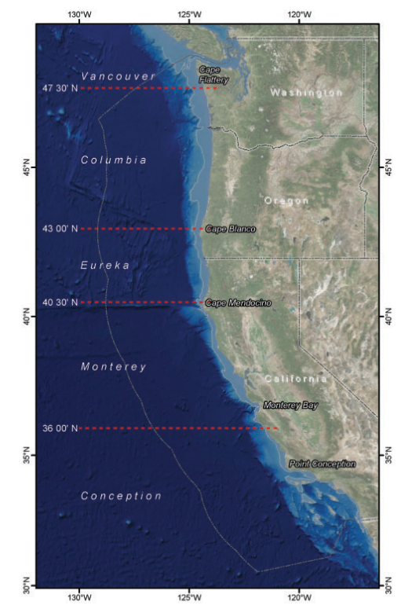
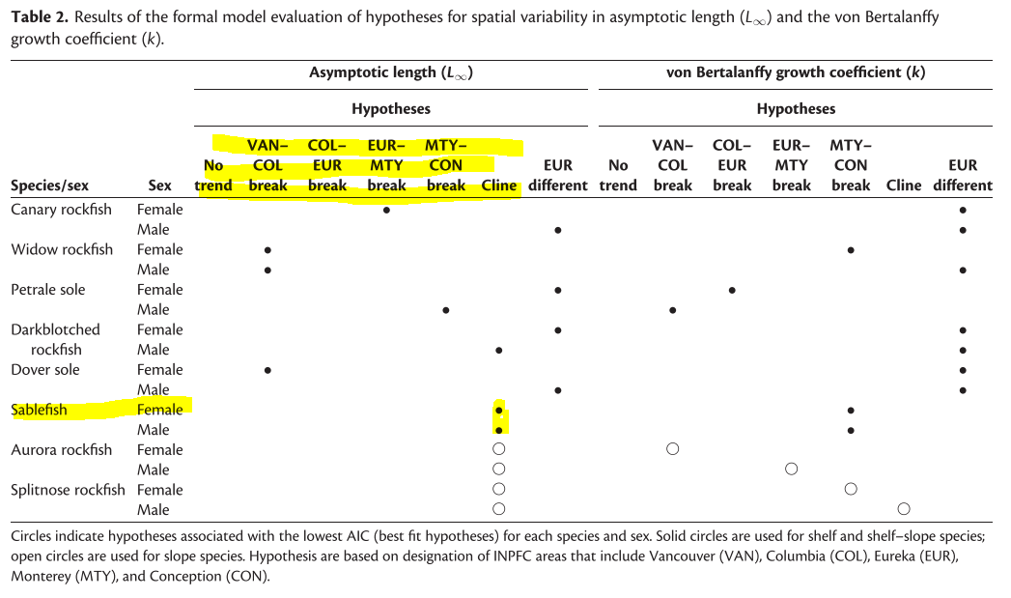
Previous work
Gertseva et al., Echave et al. – a priori breaks
Notes:
Generally pre specified

Slide 9
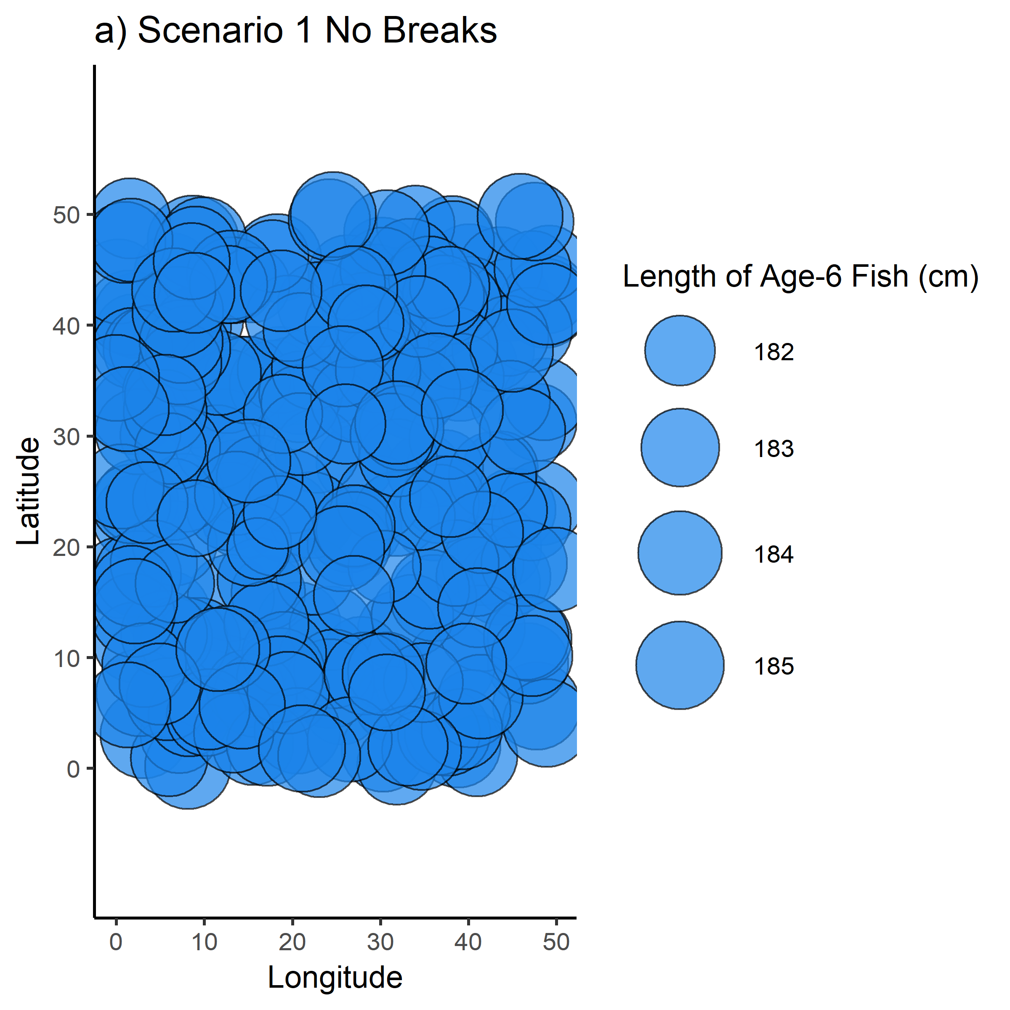
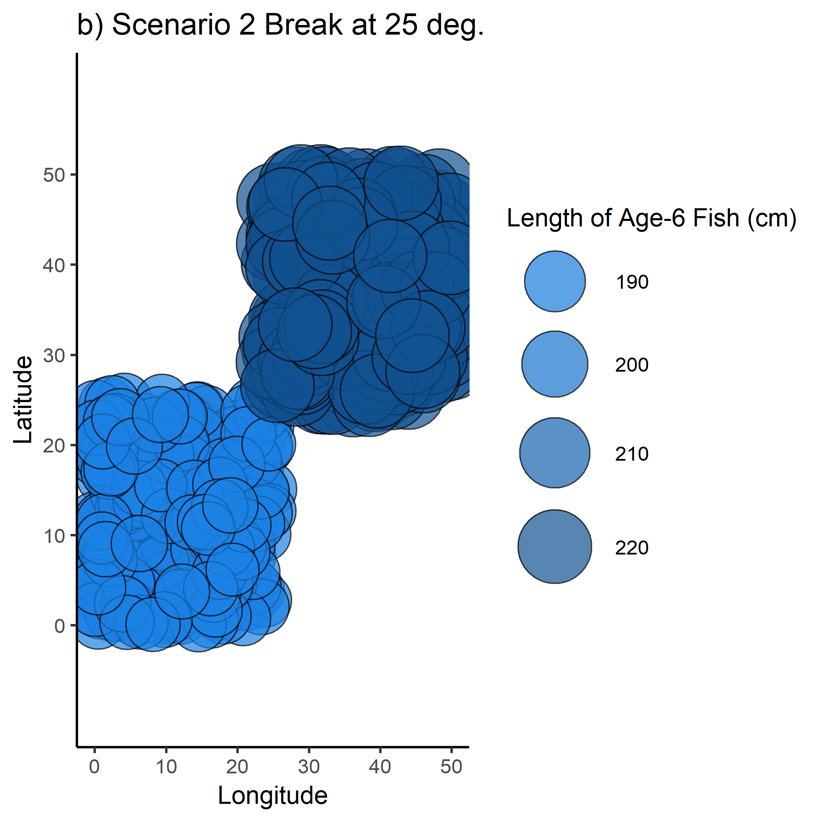
Simulation Testing
Notes:
Does this actually work?
Built an Individual Based Model with artificially-induced spatiotemporal changes
Fish in different “regions” are subject to different life-history regimes

Slide 10
How the GAM analysis looks
Filter to only have single-aged fish, to avoid age effects
GAM diagnostics generally good
100 trials each for several spatial scenarios

Slide 11
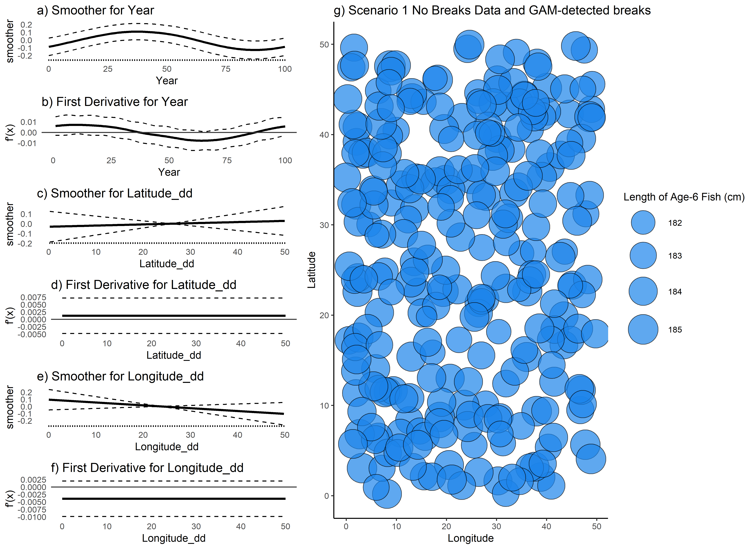
How the GAM analysis looks
No breaks identified – good!
Notes:
Walk thru the plot

Slide 12
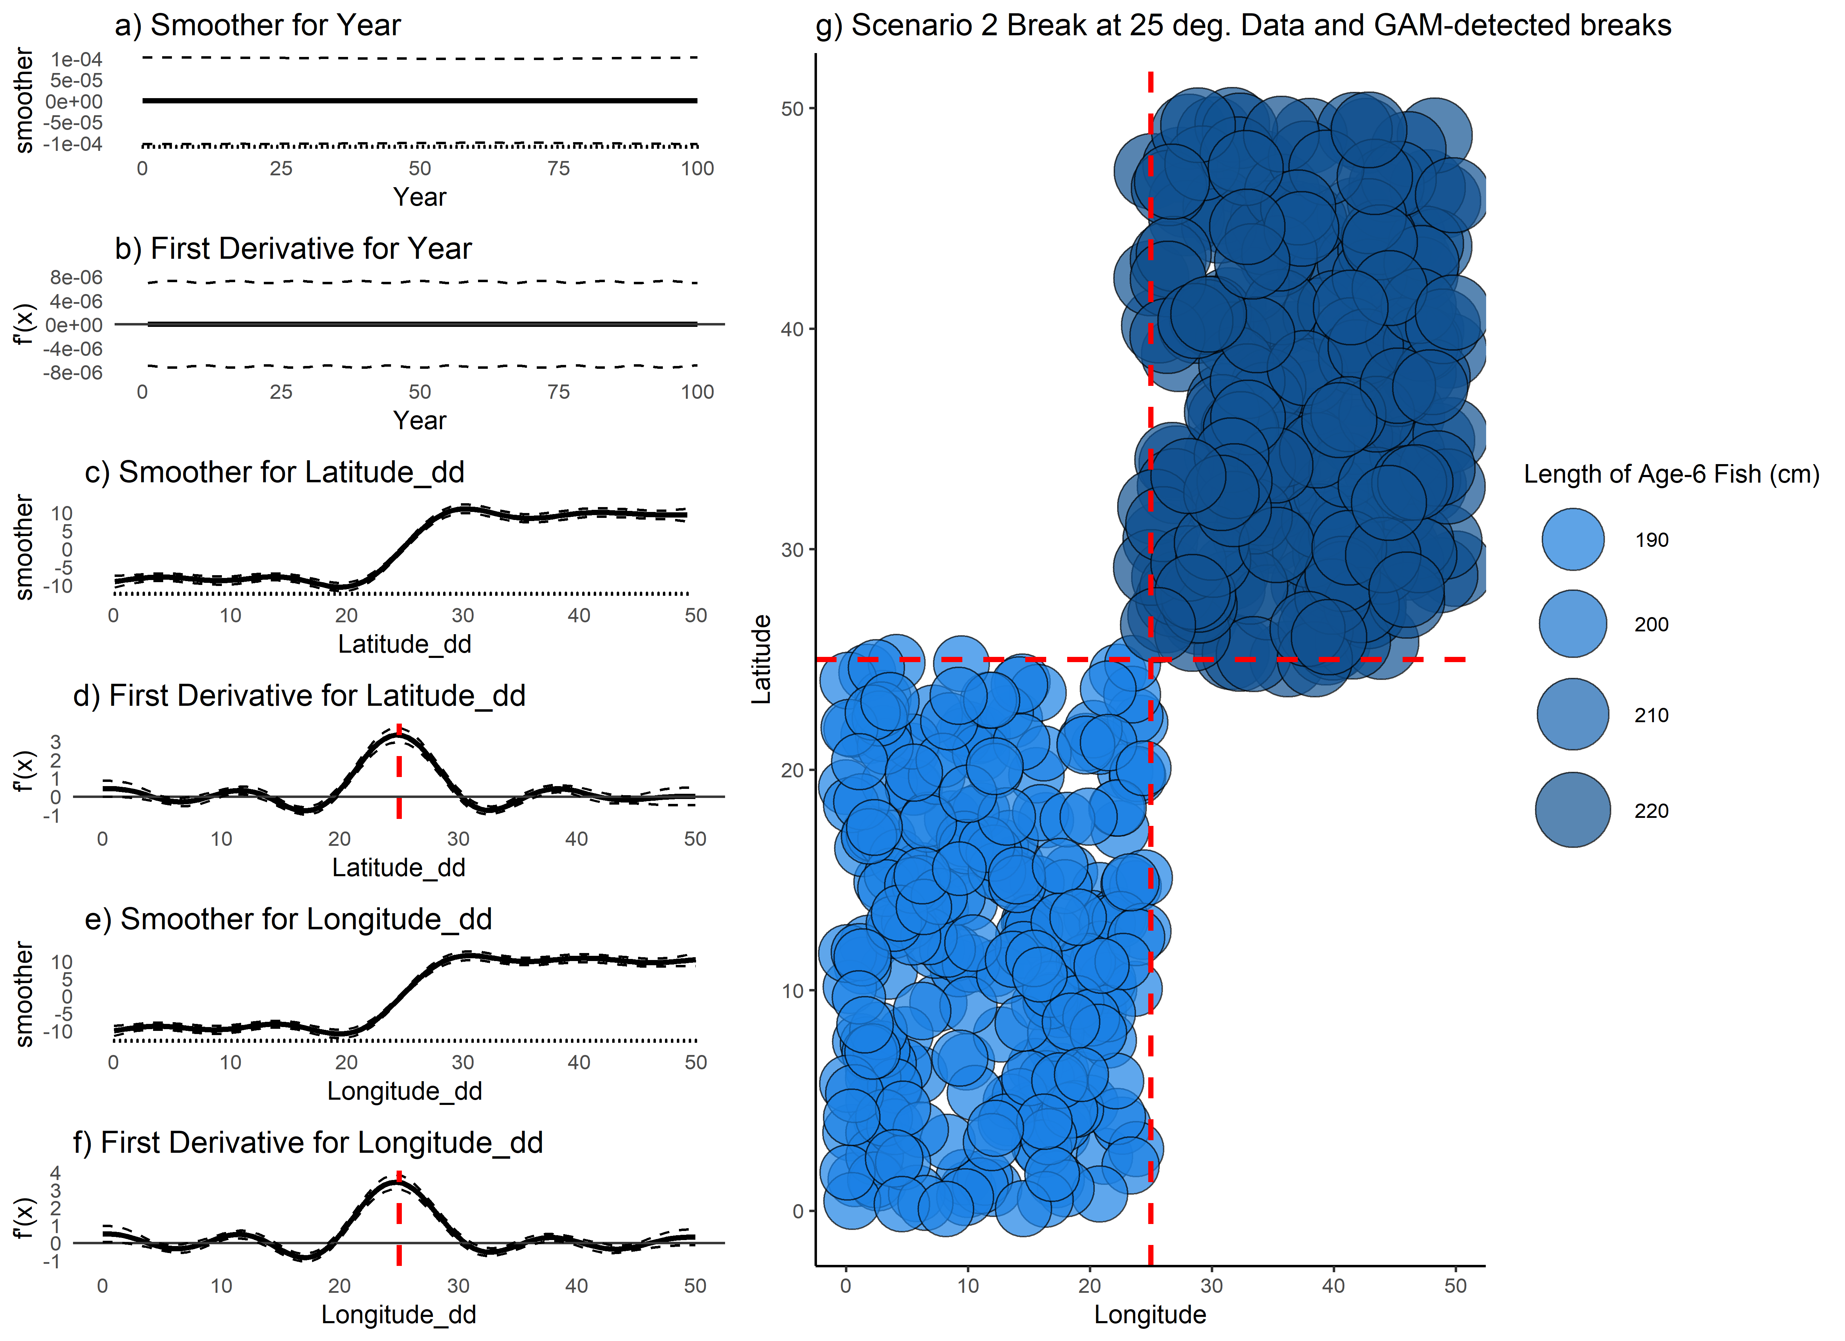
How the GAM analysis looks
Lat break @ 25, Lon break @ 25

